Slide 1
Recent improvements in MinRank and RSD

Slide 2
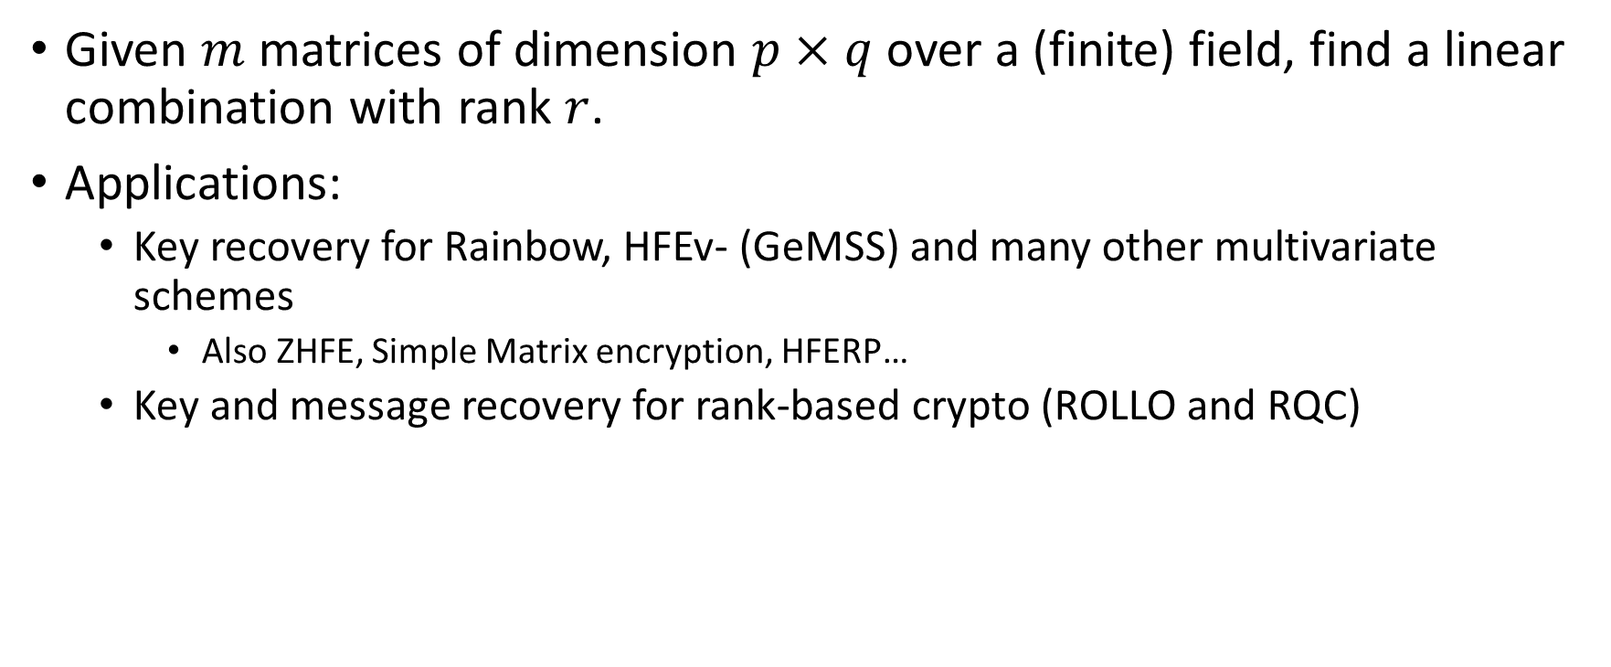
MinRank, the basic version
Given $m$ matrices of dimension $p×q$ over a (finite) field, find a linear combination with rank $r$.
Applications:
  Key recovery for Rainbow, HFEv- (GeMSS) and many other multivariate schemes
    Also ZHFE, Simple Matrix encryption, HFERP…
  Key and message recovery for rank-based crypto (ROLLO and RQC)

Slide 3
Rank Based Cryptography
Historically, Rank-Based Cryptography has been considered a subset of Code-Based Cryptography
Arguably, this makes about as much sense as including Lattice-Based Cryptography in Code-Based Cryptography
Code-Based and Rank-Based and Lattice-Based Cryptography feature similar constructions but different attacks
Rank-Based attacks look most like multivariate attacks

Slide 4
History of Rank-Based Cryptography
First (subsequently broken) scheme was proposed by Gabidulin et al. in 1991
  Assumes Gabidulin code can be hidden with linear algebra
Modern Rank-Based cryptography starts with LRPC cryptosystem proposed by Gaborit et al. in 2013
  Includes ROLLO and RQC from the NIST PQC “competition”
  NTRU-like and Ring-LWE-like schemes using an LRPC decoder (ROLLO)
  Ring-LWE-like scheme using a public Gabidulin Code (RQC)
  All security assumptions can be seen as variants of Rank Syndrome Decoding (RSD) assumption

Slide 5

Rank metric
Applies to vectors over $GF\left(q^{m}\right)$
  Note: q=2 for all parameter sets.
Use a basis over $GF(q)$ to rewrite an $n$-dimensional vector over $GF\left(q^{m}\right)$ as an $n×m$ matrix over $GF(q)$
  Compute the rank.
E.g. under the basis $(1,x,x^{2})$ for $GF(2^{3})$:
$$(1+x,0,1+x^{2},1+x,x^{2}+x)$$
Becomes
$$\left(\begin{matrix}\begin{matrix}\begin{matrix}1 \\ 1 \\ 0\end{matrix} & \begin{matrix}0 \\ 0 \\ 0\end{matrix}\end{matrix} & \begin{matrix}\begin{matrix}1 \\ 0 \\ 1\end{matrix} & \begin{matrix}1 \\ 1 \\ 0\end{matrix} & \begin{matrix}0 \\ 1 \\ 1\end{matrix}\end{matrix}\end{matrix}\right)$$
Which has rank 2

Slide 6
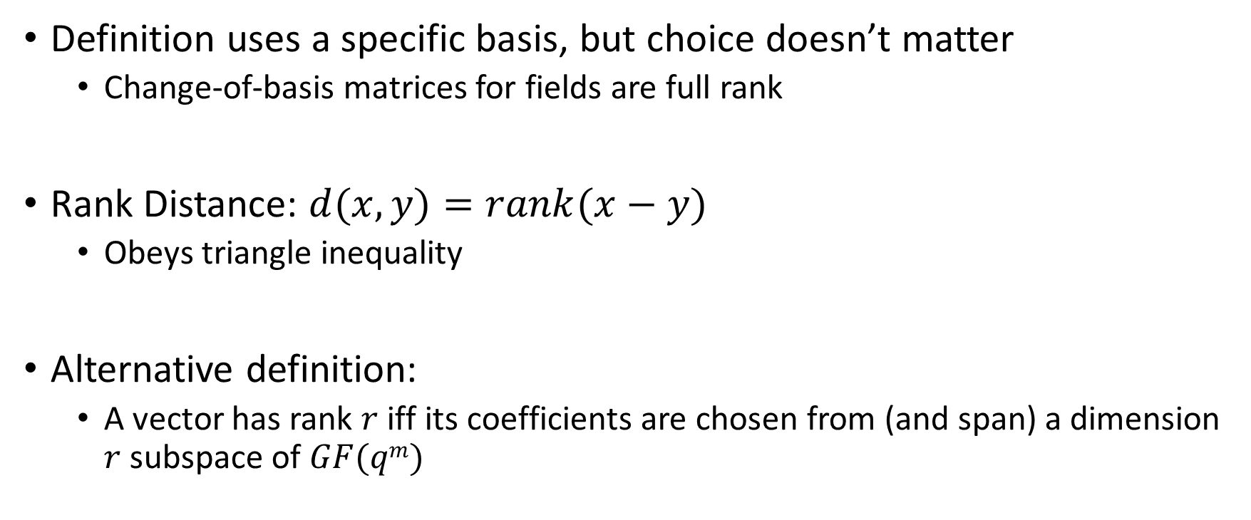
Properties of the Rank Metric
Definition uses a specific basis, but choice doesn’t matter
  Change-of-basis matrices for fields are full rank
Rank Distance: $d(x,y)=rank(x−y)$
  Obeys triangle inequality
Alternative definition:
  A vector has rank $r$ iff its coefficients are chosen from (and span) a dimension $r$ subspace of $GF(qm)$

Slide 7
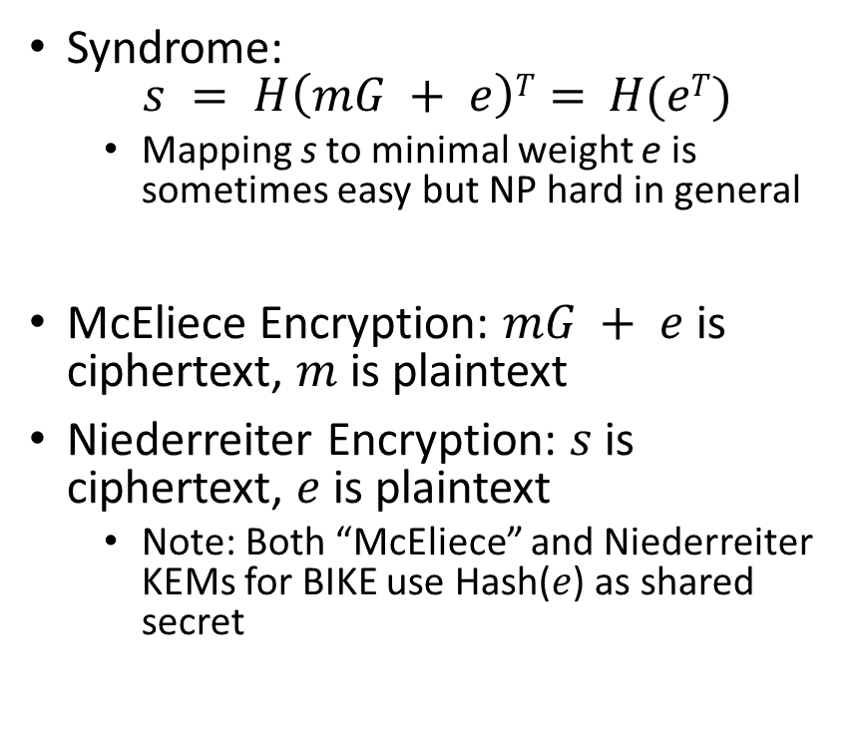
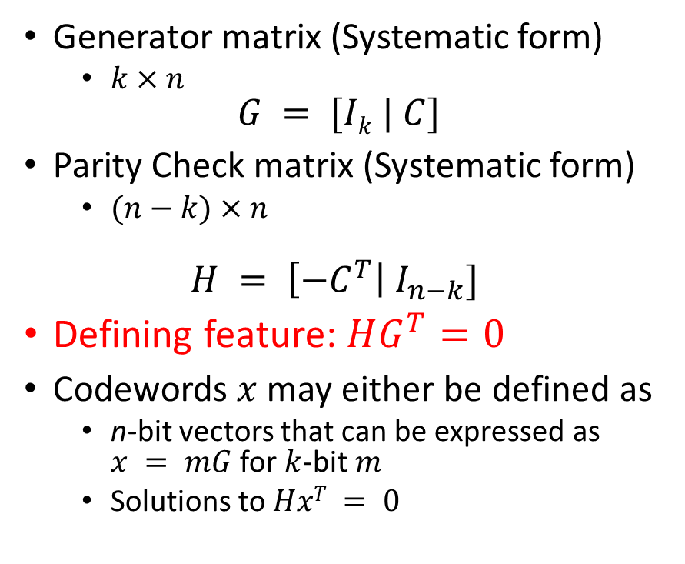
Some Coding Theory
Generator matrix (Systematic form)
  $k×n$
$$G = [Ik | C]$$
Parity Check matrix (Systematic form)
  $(n−k)×n$
$$H = \left[{−C}^{T}\right| I_{n−k}]$$
Defining feature: $HG^{T}=0$
Codewords $x$ may either be defined as
  n-bit vectors that can be expressed as $x = mG$ for $k$-bit $m$
  Solutions to $HxT = 0$
Syndrome:
$$s = H\left(mG + e\right)T= H(eT)$$
  Mapping s to minimal weight e is sometimes easy but NP hard in general
McEliece Encryption: $mG + e$is ciphertext, $m$ is plaintext
Niederreiter Encryption: $s$ is ciphertext, $e$ is plaintext
  Note: Both “McEliece” and Niederreiter KEMs for BIKE use Hash($e$) as shared secret

Slide 8
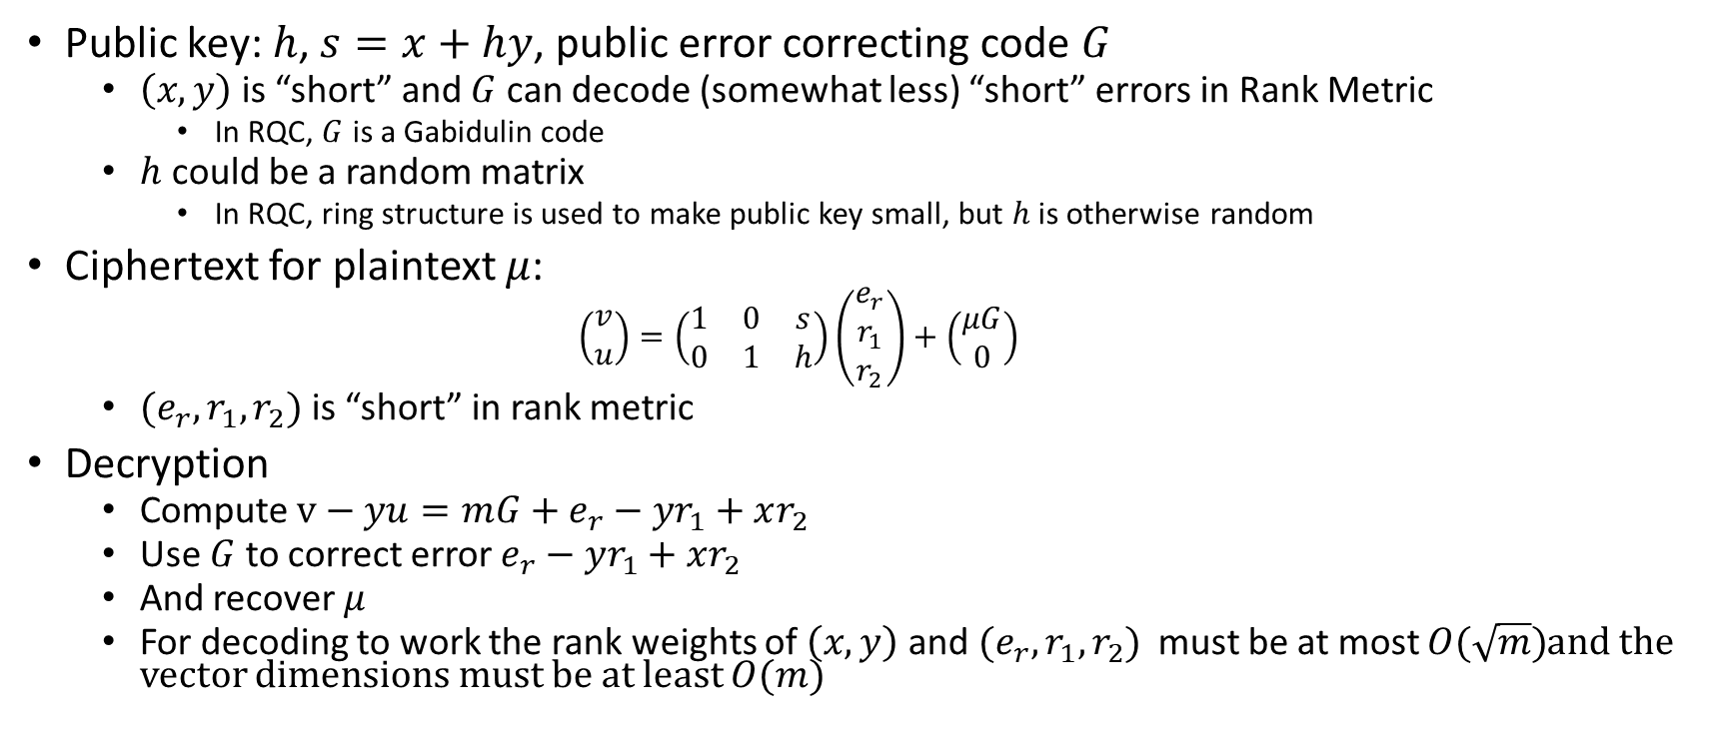
Example scheme: RQC
Public key: $h$, $s=x+hy$, public error correcting code $G$
  $\left(x,y\right)$ is “short” and $G$ can decode (somewhat less) “short” errors in Rank Metric
    In RQC, $G$ is a Gabidulin code
  $h$ could be a random matrix
    In RQC, ring structure is used to make public key small, but $h$ is otherwise random
Ciphertext for plaintext $μ$:
    $$\left(\begin{matrix}v \\ u\end{matrix}\right)=\left(\begin{matrix}1 & 0 & s \\ 0 & 1 & h\end{matrix}\right)\left(\begin{matrix}e_{r} \\ r_{1} \\ r_{2}\end{matrix}\right)+\left(\begin{matrix}μG \\ 0\end{matrix}\right)$$
  $(e_{r},r_{1},r_{2})$ is “short” in rank metric
Decryption
  Compute $v−yu={mG+e}_{r}−yr_{1}+xr_{2}$
  Use $G$ to correct error $e_{r}−yr_{1}+xr_{2}$
  And recover $μ$
  For decoding to work the rank weights of $\left(x,y\right)$ and $(e_{r},r_{1},r_{2})$ must be at most $O(\sqrt{m})$and the vector dimensions must be at least $O(m)$

Slide 9
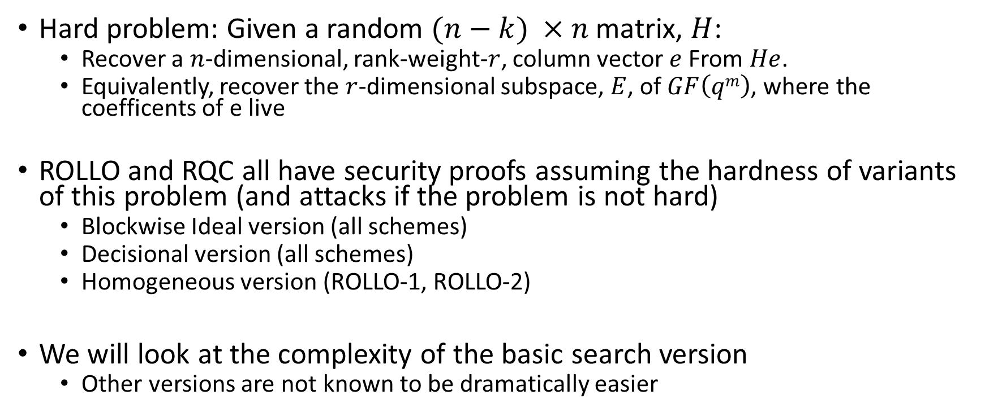
Rank Syndrome Decoding (RSD)
Hard problem: Given a random $(n−k) ×n$ matrix, $H$:
  Recover a $n$-dimensional, rank-weight-$r$, column vector $e$ From $He$.
  Equivalently, recover the $r$-dimensional subspace, $E$, of $GF\left(qm\right)$, where the coefficents of e live
ROLLO and RQC all have security proofs assuming the hardness of variants of this problem (and attacks if the problem is not hard)
  Blockwise Ideal version (all schemes)
  Decisional version (all schemes)
  Homogeneous version (ROLLO-1, ROLLO-2)
We will look at the complexity of the basic search version
  Other versions are not known to be dramatically easier

Slide 10
RSD attacks
Almost all published research on RSD is by the authors of ROLLO and RQC
  Needs more study
Parameters for ROLLO, RQC set based on “support trapping” attack
Personal opinion
  RSD looks very closely related to multivariate cryptanalysis techniques (MinRank in particular)
    Very different parameters, though!
  More interaction with the multivariate community could increase confidence that we know the concrete hardness of RSD problem
  We’re currently working on research in this direction

Slide 11
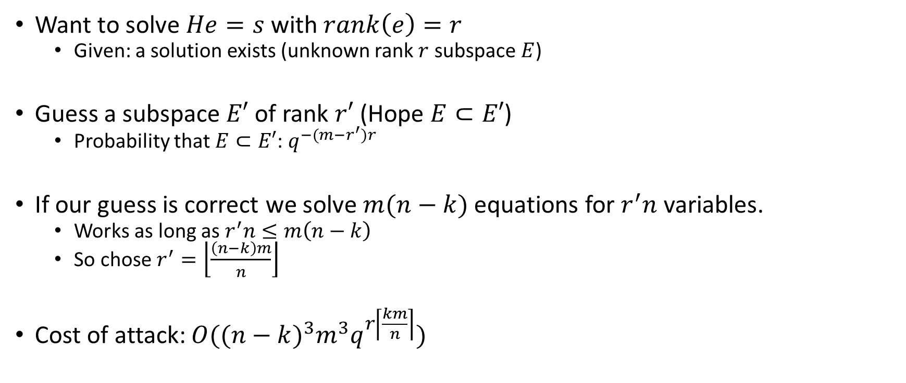
Support Trapping Attack
[Gaborit, Ruatta, Schrek 2013]
Want to solve $He=s$ with $rank\left(e\right)=r$
  Given: a solution exists (unknown rank $r$ subspace $E$)
Guess a subspace$E′$ of rank $r′$ (Hope $E⊂E′$)
  Probability that $E⊂E′$: $q^{−(m−r^{′})r}$
If our guess is correct we solve $m(n−k)$ equations for $r^{′}n$ variables.
  Works as long as $r^{′}n≤m\left(n−k\right)$
  So chose $r^{′}=\left\lfloor \frac{\left(n−k\right)m}{n}\right\rfloor$
Cost of attack: $O({(n−k)}^{3}m^{3}q^{r\left\lceil \frac{km}{n}\right\rceil })$

Slide 12
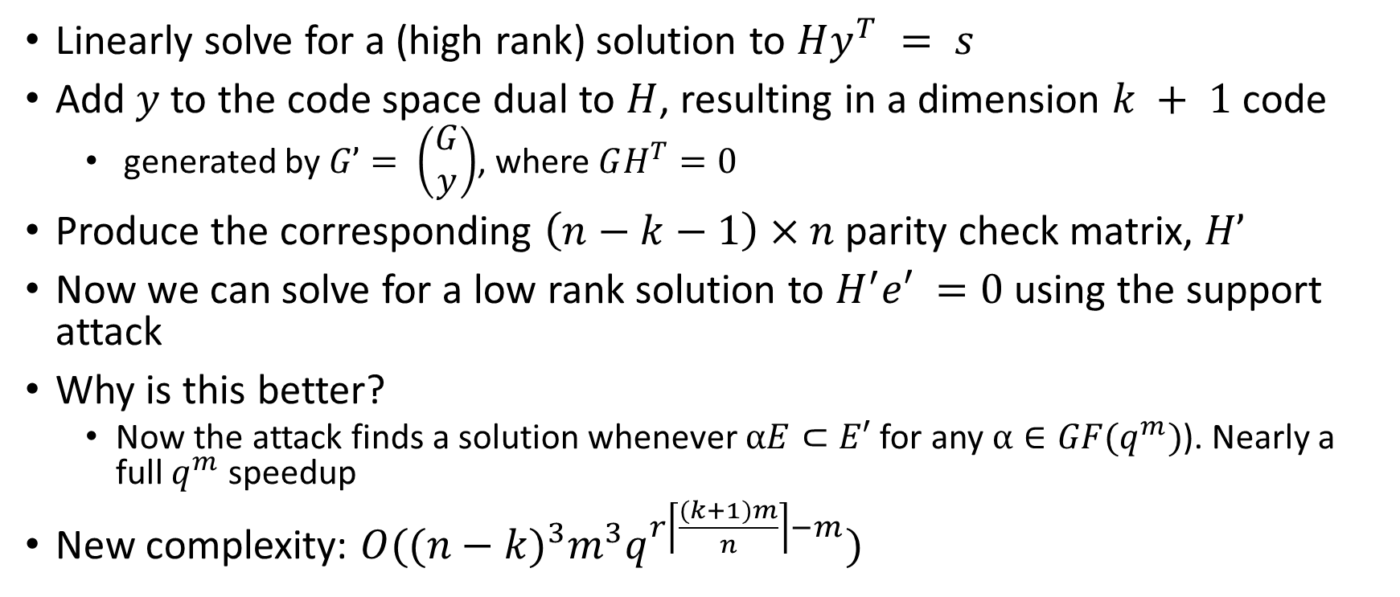
Support Trapping Attack Improved
[Aragon, Gaborit, Hauteville, Tillich 2018]
Linearly solve for a (high rank) solution to $Hy^{T} = s$
Add $y$ to the code space dual to $H$, resulting in a dimension $k + 1$code
  generated by $G’= \left(\begin{matrix}G \\ y\end{matrix}\right)$, where $GH^{T}=0$
Produce the corresponding $\left(n−k−1\right)×n$ parity check matrix, $H’$
Now we can solve for a low rank solution to $H^{′}e′ =0$ using the support attack
Why is this better?
  Now the attack finds a solution whenever $αE⊂E′$ for any $α∈GF(q^{m})$). Nearly a full $q^{m}$ speedup
New complexity: $O({(n−k)}^{3}m^{3}q^{r\left\lceil \frac{(k+1)m}{n}\right\rceil −m})$

Slide 13
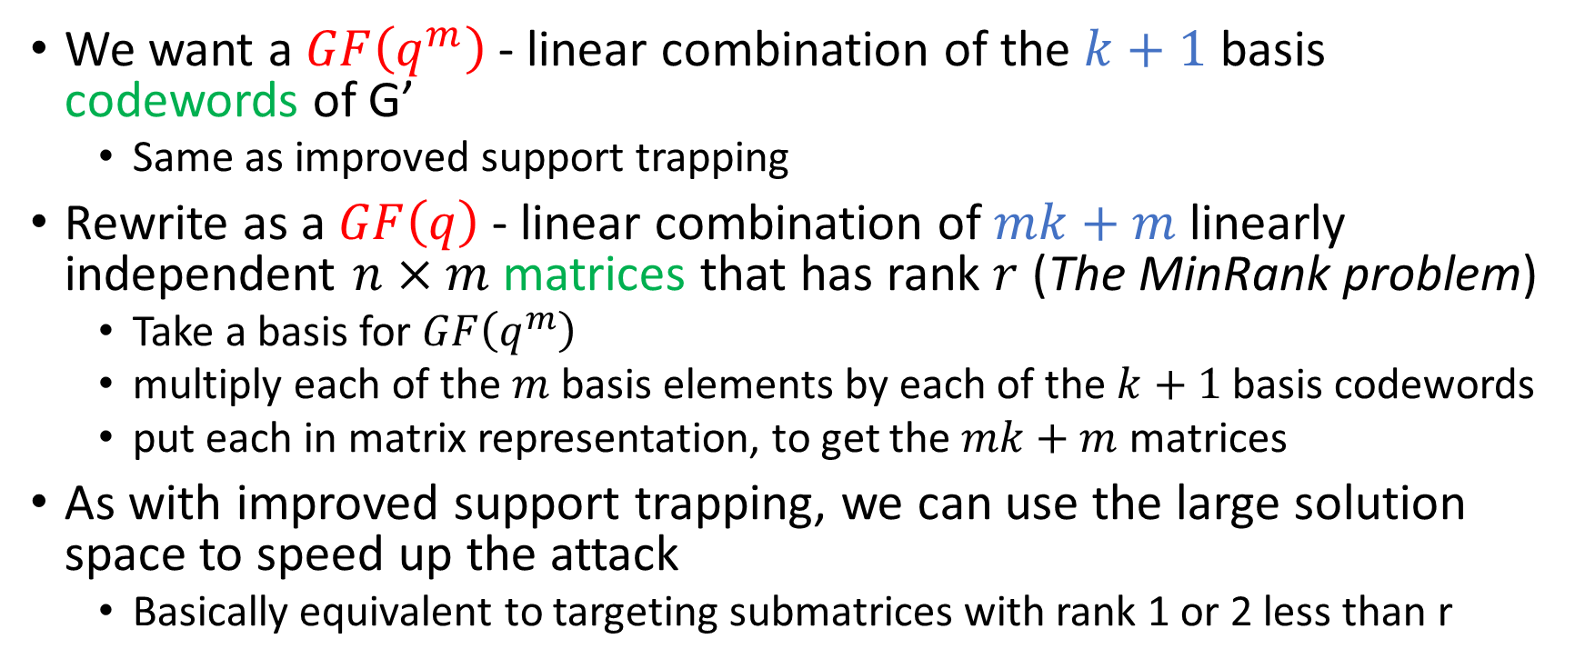
Rank Syndrome Decoding as MinRank
We want a $GF\left(q^{m}\right)$ - linear combination of the $k+1$ basis codewords of G’
  Same as improved support trapping
Rewrite as a $GF\left(q\right)$ - linear combination of $mk+m$ linearly independent $n×m$matrices that has rank $r$ (The MinRank problem)
  Take a basis for $GF\left(q^{m}\right)$
  multiply each of the $m$ basis elements by each of the $k+1$basis codewords
  put each in matrix representation, to get the $mk+m$ matrices
As with improved support trapping, we can use the large solution space to speed up the attack
  Basically equivalent to targeting submatrices with rank 1 or 2 less than r

Slide 14
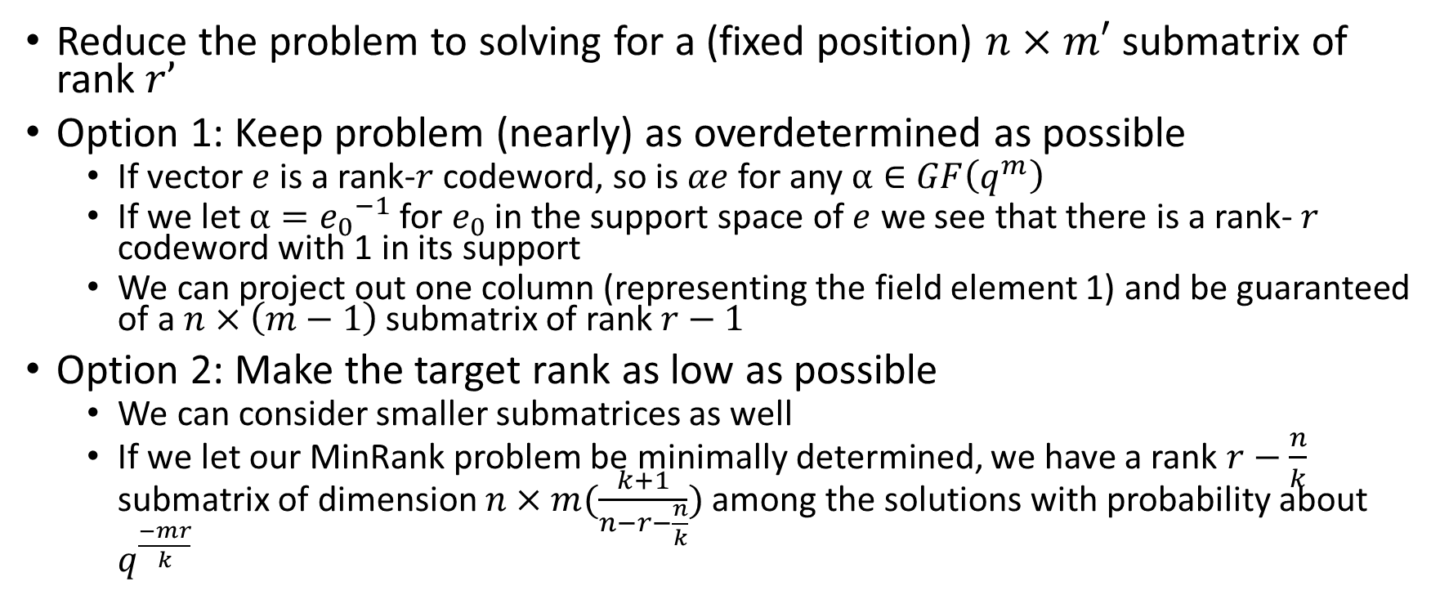
Using the large Solution space
Reduce the problem to solving for a (fixed position) $n×m′$ submatrix of rank $r’$
Option 1: Keep problem (nearly) as overdetermined as possible
  If vector $e$ is a rank-$r$ codeword, so is $αe$ for any $α∈GF\left(q^{m}\right)$
  If we let $α={e_{0}}^{−1}$ for $e_{0}$ in the support space of $e$ we see that there is a rank- $r$ codeword with 1 in its support
  We can project out one column (representing the field element 1) and be guaranteed of a $n×\left(m−1\right)$ submatrix of rank $r−1$
Option 2: Make the target rank as low as possible
  We can consider smaller submatrices as well
  If we let our MinRank problem be minimally determined, we have a rank $r−\frac{n}{k}$ submatrix of dimension $n×m(\frac{k+1}{n−r−\frac{n}{k}})$ among the solutions with probability about $q^{\frac{−mr}{k}}$

Slide 15
Standard Techniques for MinRank:
1. Linear Algebra Search
Important technique for attacking multivariate scheme, Rainbow
Steps:
  Guess subspace of right or left kernel of target matrix
  If correct, solve linearly for combination of matrices having guessed kernel
  Repeat as necessary
Compare to support trapping:
  Guess space containing row or column space of target matrix
  If correct, solve linearly for combination of matrices having row/column space
  Repeat as necessary
These appear to be dual descriptions of the same attack

Slide 16
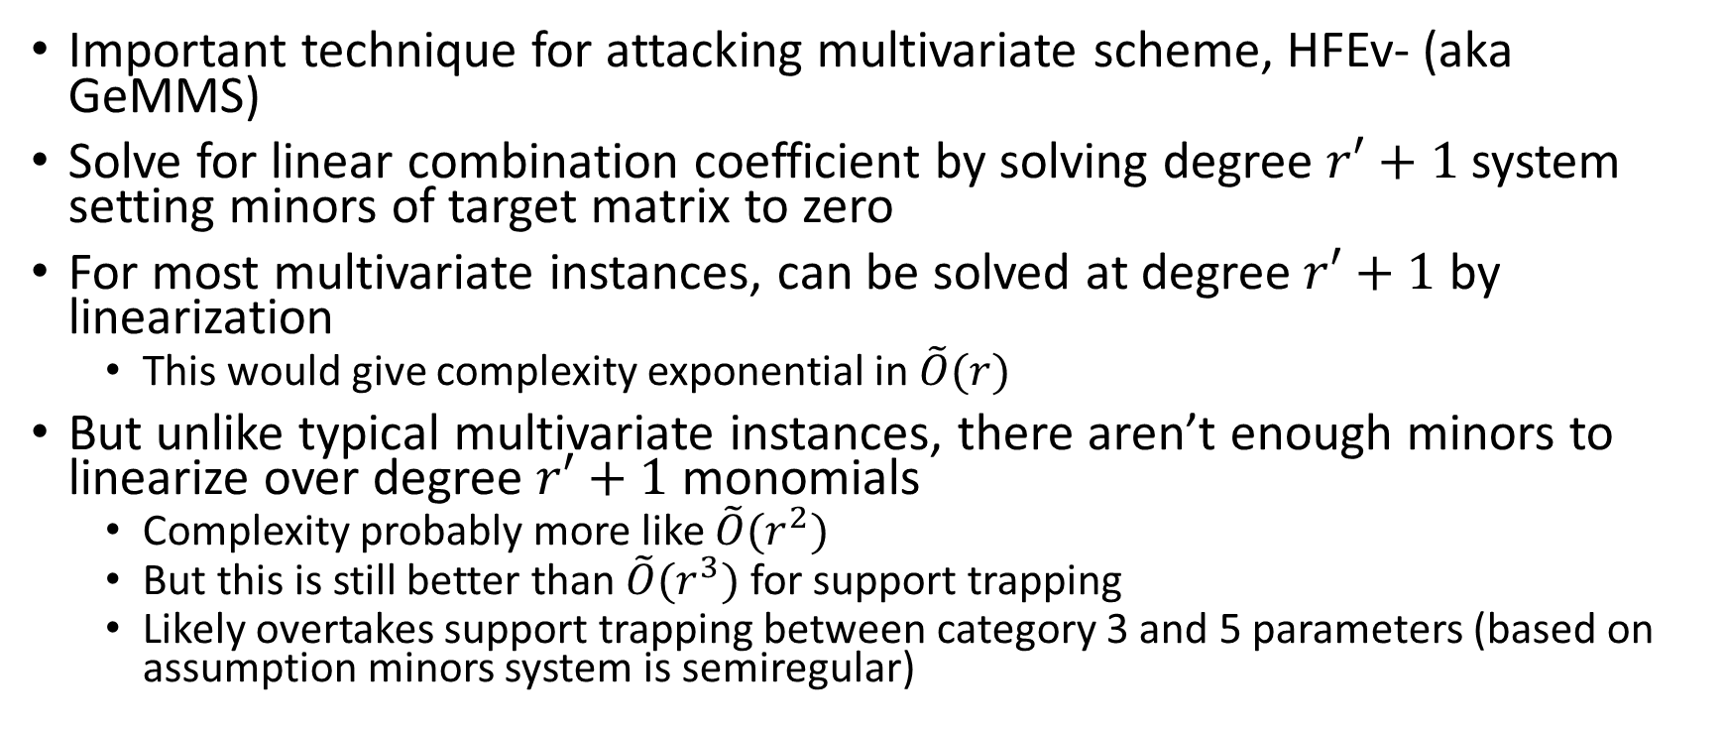
Standard Techniques for MinRank:
2. Minors Modeling
Important technique for attacking multivariate scheme, HFEv- (aka GeMMS)
Solve for linear combination coefficient by solving degree $r′+1$ system setting minors of target matrix to zero
For most multivariate instances, can be solved at degree $r′+1$ by linearization
  This would give complexity exponential in $\tilde{O}(r)$
But unlike typical multivariate instances, there aren’t enough minors to linearize over degree $r′+1$ monomials
  Complexity probably more like $\tilde{O}(r^{2})$
  But this is still better than $\tilde{O}(r^{3})$ for support trapping
  Likely overtakes support trapping between category 3 and 5 parameters (based on assumption minors system is semiregular)

Slide 17
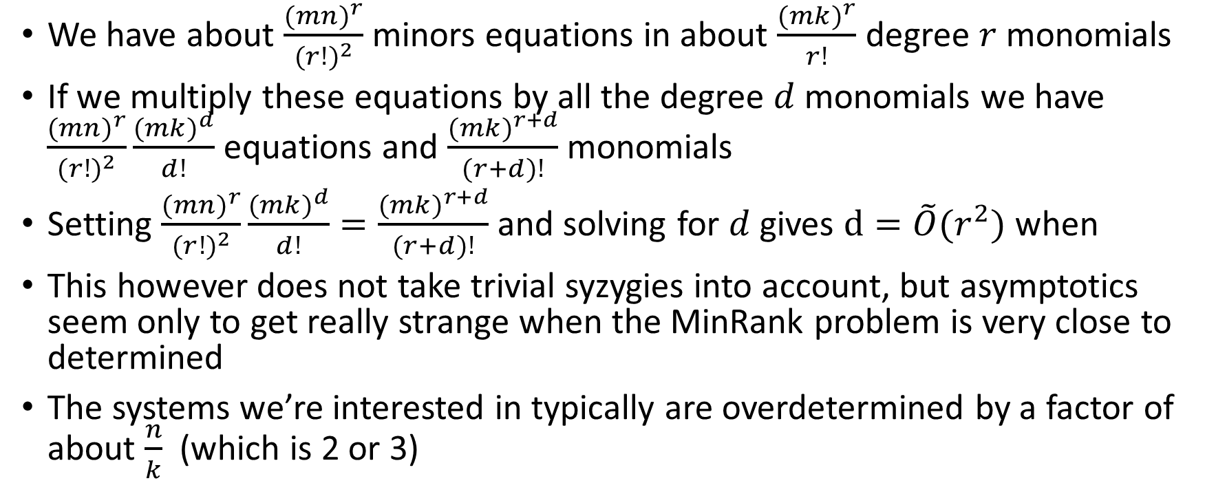

Heuristic argument that solving degree for minors should be $\tilde{O}(r^{2})$
We have about $\frac{{(mn)}^{r}}{{(r!)}^{2}}$ minors equations in about $\frac{({mk)}^{r}}{r!}$ degree $r$ monomials
If we multiply these equations by all the degree $d$ monomials we have $\frac{{(mn)}^{r}}{{(r!)}^{2}}\frac{{(mk)}^{d}}{d!}$ equations and $\frac{({mk)}^{r+d}}{(r+d)!}$ monomials
Setting $\frac{{(mn)}^{r}}{{(r!)}^{2}}\frac{{(mk)}^{d}}{d!}=\frac{({mk)}^{r+d}}{(r+d)!}$ and solving for $d$ gives $d=\tilde{O}(r^{2})$ when
This however does not take trivial syzygies into account, but asymptotics seem only to get really strange when the MinRank problem is very close to determined
The systems we’re interested in typically are overdetermined by a factor of about $\frac{n}{k}$ (which is 2 or 3)

Slide 18
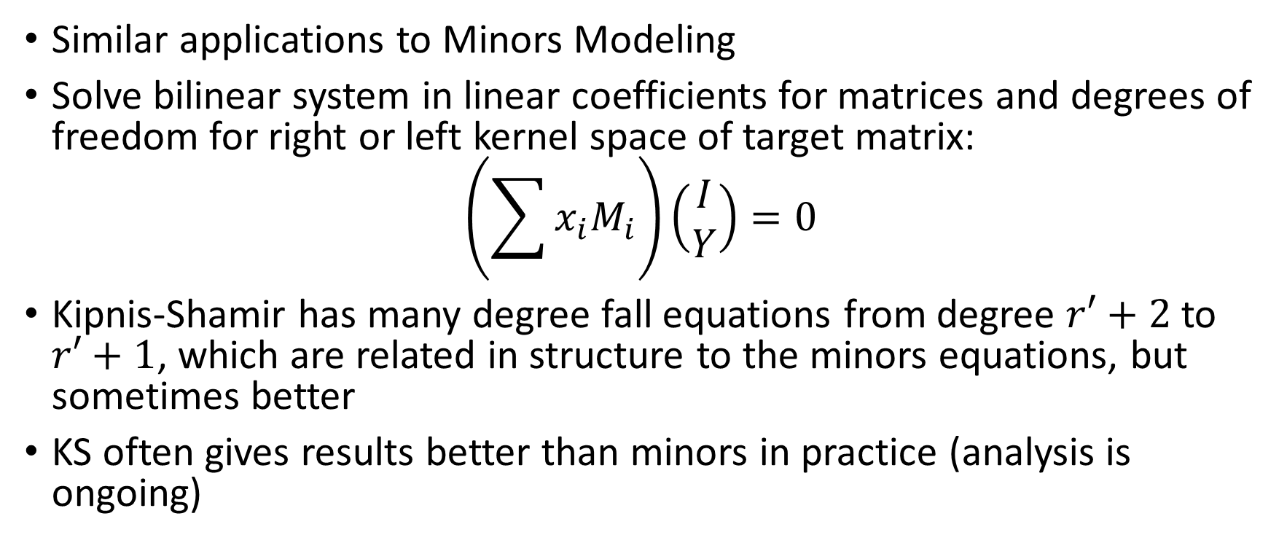
Standard Techniques for MinRank
3. Kipnis-Shamir
Similar applications to Minors Modeling
Solve bilinear system in linear coefficients for matrices and degrees of freedom for right or left kernel space of target matrix:
$$\left(\sum{x_{i}M_{i}}\right)\left(\begin{matrix}I \\ Y\end{matrix}\right)=0$$
Kipnis-Shamir has many degree fall equations from degree $r′+2$ to $r′+1$, which are related in structure to the minors equations, but sometimes better
KS often gives results better than minors in practice (analysis is ongoing)

Slide 19
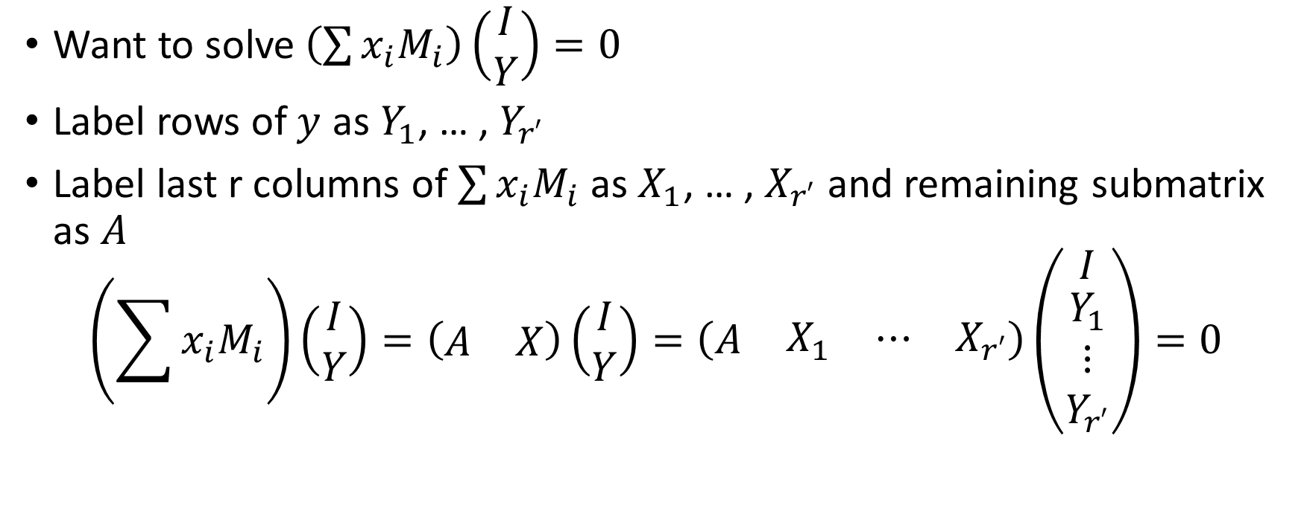
Notation for KS equations
Want to solve $\left(\sum{x_{i}M_{i}}\right)\left(\begin{matrix}I \\ Y\end{matrix}\right)=0$
Label rows of $y$ as $Y_{1}$, … , $Y_{r′}$
Label last r columns of $\sum{x_{i}M_{i}}$ as $X_{1}$, … , $X_{r′}$ and remaining submatrix as $A$
$$\left(\sum{x_{i}M_{i}}\right)\left(\begin{matrix}I \\ Y\end{matrix}\right)=\left(\begin{matrix}A & X\end{matrix}\right)\left(\begin{matrix}I \\ Y\end{matrix}\right)=\left(\begin{matrix}A & \begin{matrix}X_{1} & ⋯ & X_{r′}\end{matrix}\end{matrix}\right)\left(\begin{matrix}I \\ \begin{matrix}Y_{1} \\ ⋮ \\ Y_{r′}\end{matrix}\end{matrix}\right)=0$$

Slide 20
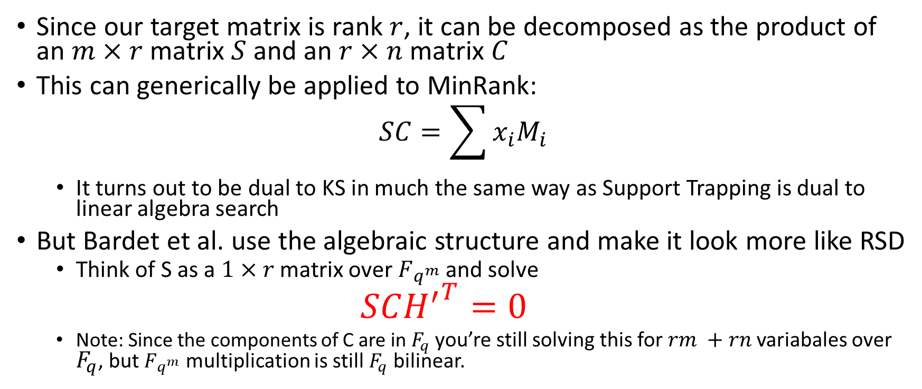
A better way: Syndrome modeling
(Bardet, Bros, Gaborit, Neiger, Ruatta, Tillich 2019) https://arxiv.org/abs/1910.00810
Since our target matrix is rank $r$, it can be decomposed as the product of an $m×r$ matrix $S$ and an $r×n$ matrix $C$
This can generically be applied to MinRank:
$$SC=\sum{x_{i}M_{i}}$$
  It turns out to be dual to KS in much the same way as Support Trapping is dual to linear algebra search
But Bardet et al. use the algebraic structure and make it look more like RSD
  Think of S as a $1×r$ matrix over $F_{q^{m}}$ and solve
  $$SC{H^{′}}^{T}=0$$
  Note: Since the components of C are in $F_{q}$ you’re still solving this for $rm +rn$variabales over $F_{q}$, but $F_{q^{m}}$ multiplication is still $F_{q}$ bilinear.

Slide 21
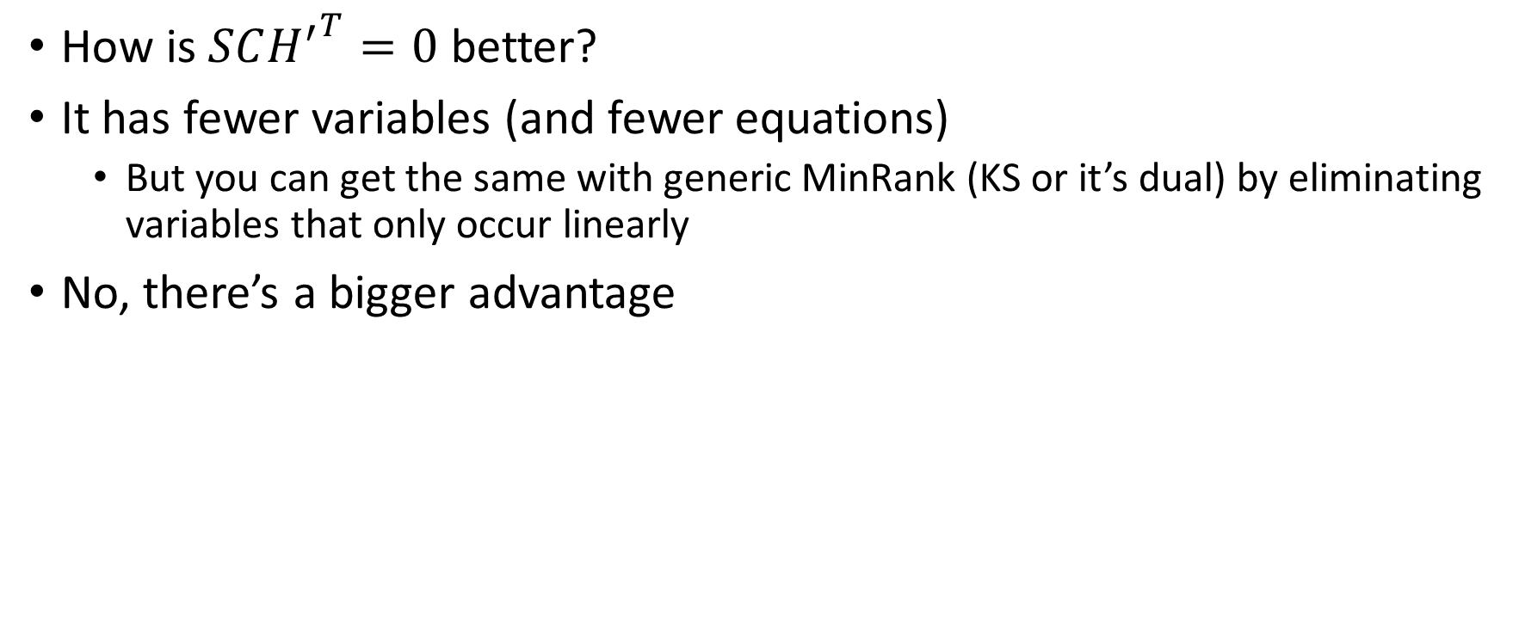
Bardet et al. Continued
Using algebraic structure how?
How is $SC{H^{′}}^{T}=0$ better?
It has fewer variables (and fewer equations)
  But you can get the same with generic MinRank (KS or it’s dual) by eliminating variables that only occur linearly
No, there’s a bigger advantage

Slide 22
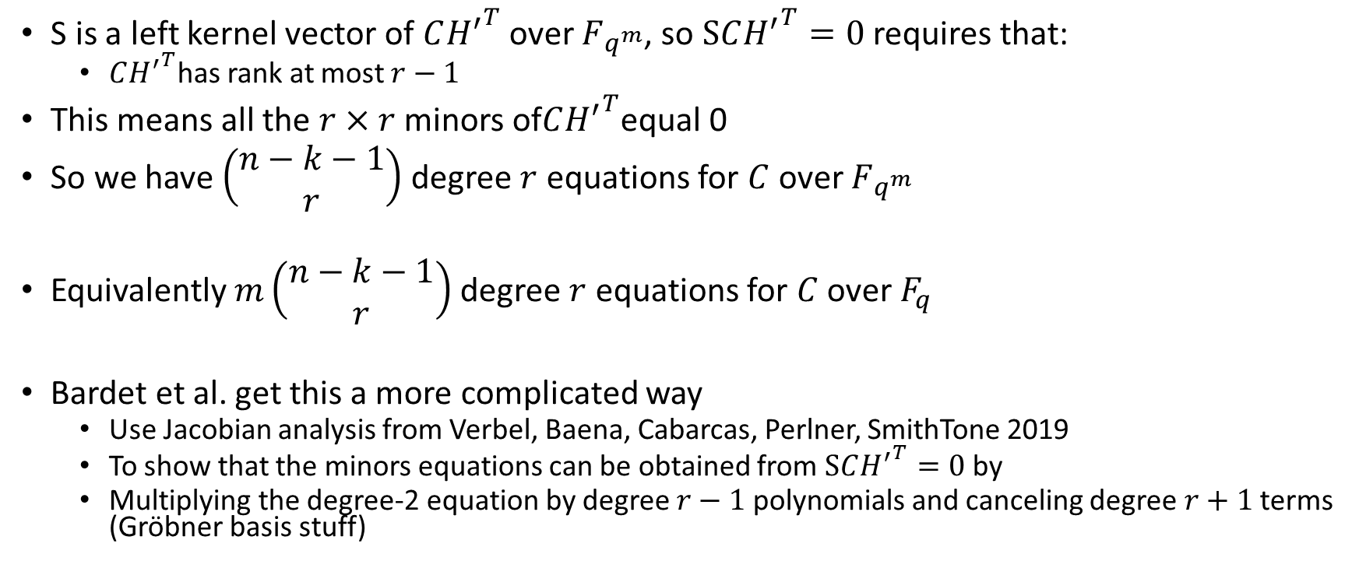

Bardet et al. Continued
MaxMinors($C{H′}^{T}$)
S is a left kernel vector of $C{H^{′}}^{T}$ over $F_{q^{m}}$, so $SC{H^{′}}^{T}=0$ requires that:
  $C{H^{′}}^{T}$has rank at most $r−1$
This means all the $r×r$ minors of$C{H^{′}}^{T}$equal 0
So we have $\left(\begin{matrix}n−k−1 \\ r\end{matrix}\right)$ degree $r$ equations for $C$ over $F_{q^{m}}$
Equivalently $m\left(\begin{matrix}n−k−1 \\ r\end{matrix}\right)$ degree $r$ equations for $C$ over $F_{q}$
Bardet et al. get this a more complicated way
  Use Jacobian analysis from Verbel, Baena, Cabarcas, Perlner, SmithTone 2019
  To show that the minors equations can be obtained from $SC{H^{′}}^{T}=0$ by
  Multiplying the degree-2 equation by degree $r−1$ polynomials and canceling degree $r+1$ terms (Gröbner basis stuff)

Slide 23
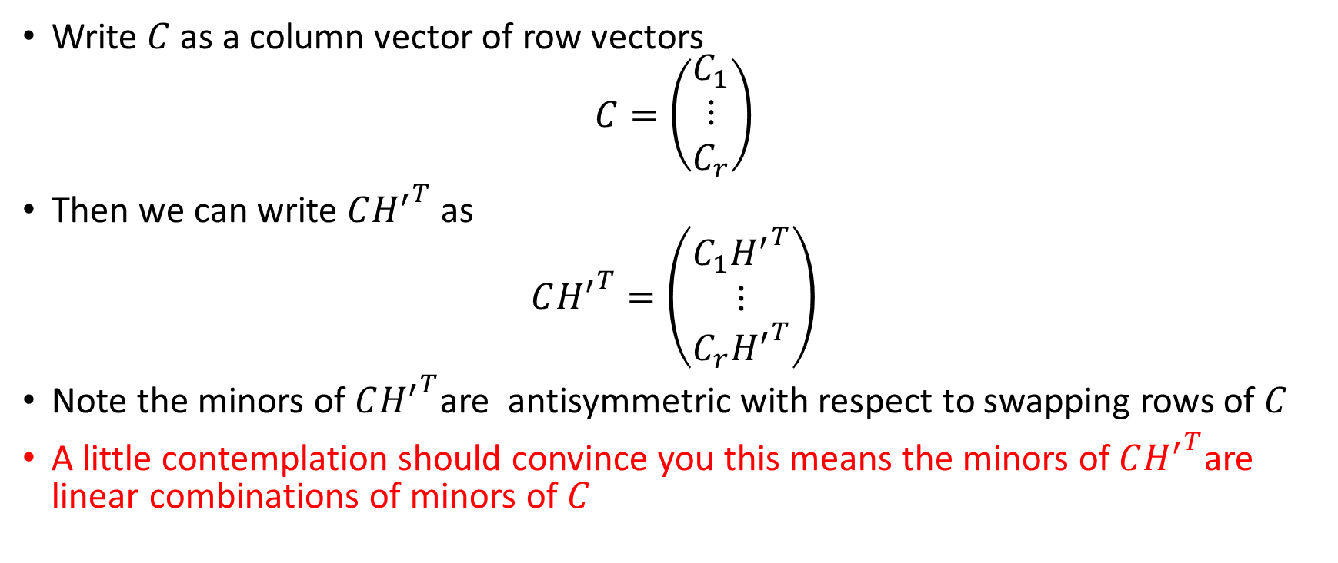
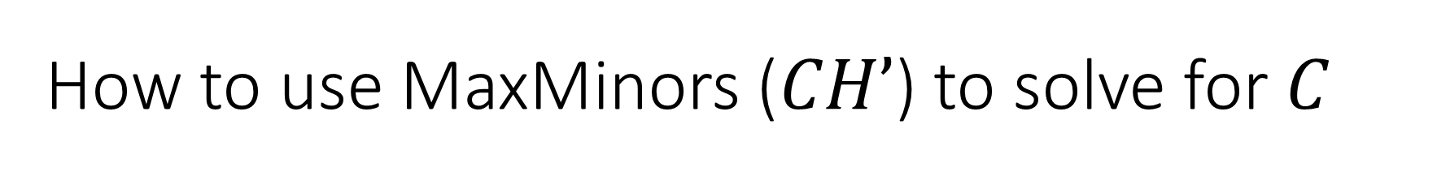
How to use MaxMinors ($CH’$) to solve for $C$
Write $C$ as a column vector of row vectors
$$C=\left(\begin{matrix}C_{1} \\ ⋮ \\ C_{r}\end{matrix}\right)$$
Then we can write $C{H^{′}}^{T}$ as
$$C{H^{′}}^{T}=\left(\begin{matrix}C_{1}{H^{′}}^{T} \\ ⋮ \\ C_{r}{H^{′}}^{T}\end{matrix}\right)$$
Note the minors of $C{H^{′}}^{T}$are antisymmetric with respect to swapping rows of $C$
A little contemplation should convince you this means the minors of$C{H^{′}}^{T}$are linear combinations of minors of $C$

Slide 24
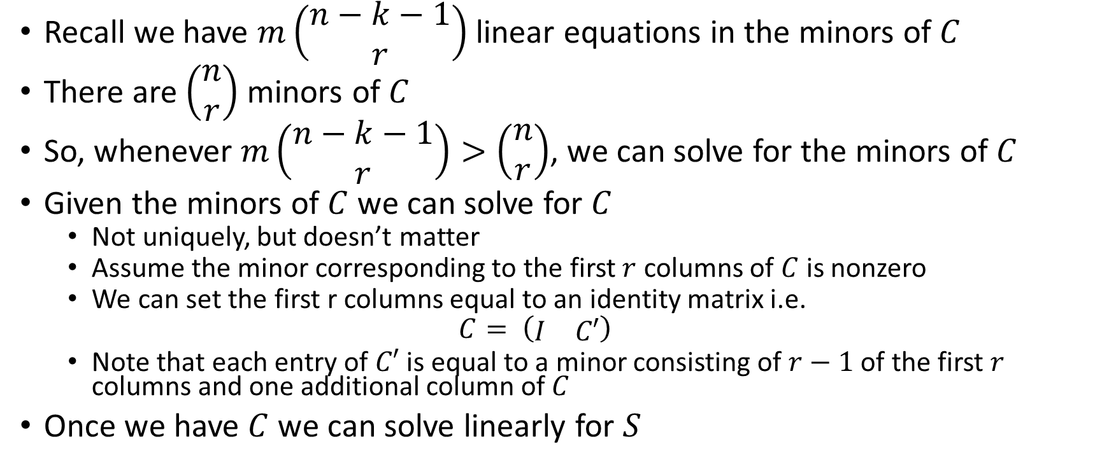
How to use MaxMinors ($CH’$) to solve for $C$
Recall we have $m\left(\begin{matrix}n−k−1 \\ r\end{matrix}\right)$ linear equations in the minors of $C$
There are $\left(\begin{matrix}n \\ r\end{matrix}\right)$ minors of $C$
So, whenever $m\left(\begin{matrix}n−k−1 \\ r\end{matrix}\right)>\left(\begin{matrix}n \\ r\end{matrix}\right)$, we can solve for the minors of $C$
Given the minors of $C$ we can solve for $C$
  Not uniquely, but doesn’t matter
  Assume the minor corresponding to the first $r$ columns of $C$ is nonzero
  We can set the first r columns equal to an identity matrix i.e.
  $$C= \left(\begin{matrix}I & C′\end{matrix}\right)$$
  Note that each entry of $C′$ is equal to a minor consisting of $r−1$ of the first $r$ columns and one additional column of $C$
Once we have $C$ we can solve linearly for $S$

Slide 25
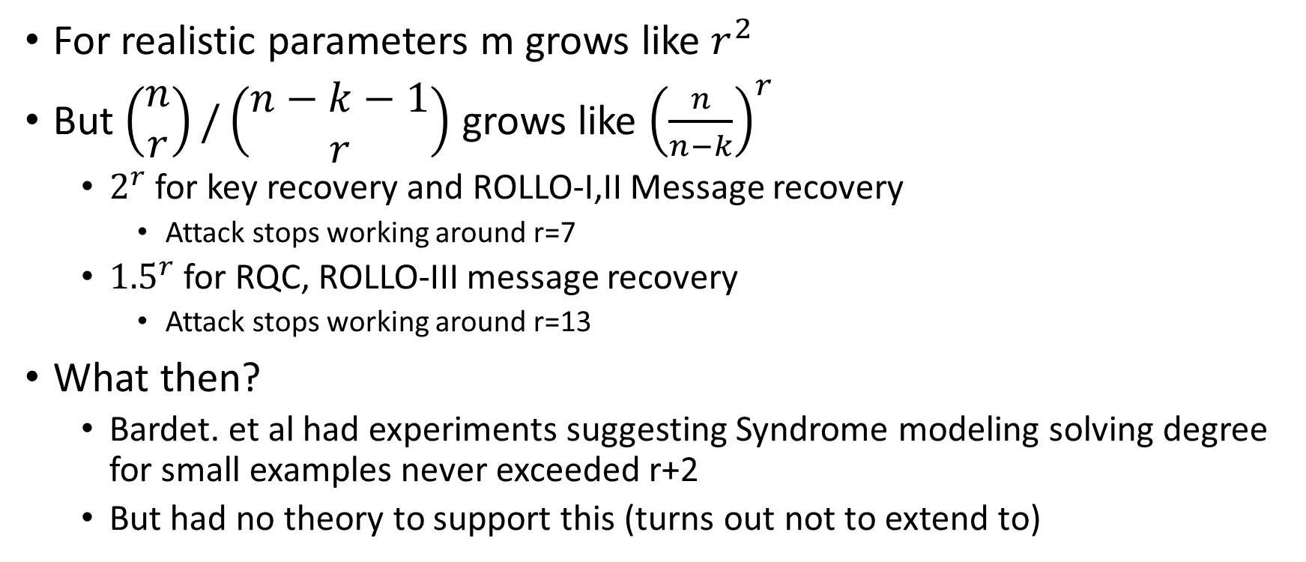

What if $m\left(\begin{matrix}n−k−1 \\ r\end{matrix}\right)<\left(\begin{matrix}n \\ r\end{matrix}\right)$?
For realistic parameters m grows like $r^{2}$
But $\left(\begin{matrix}n \\ r\end{matrix}\right)/\left(\begin{matrix}n−k−1 \\ r\end{matrix}\right)$ grows like ${\left(\frac{n}{n−k}\right)}^{r}$
  $2^{r}$ for key recovery and ROLLO-I,II Message recovery
    Attack stops working around r=7
  ${1.5}^{r}$ for RQC, ROLLO-III message recovery
    Attack stops working around r=13
What then?
  Bardet. et al had experiments suggesting Syndrome modeling solving degree for small examples never exceeded r+2
  But had no theory to support this (turns out not to extend to)

Slide 26
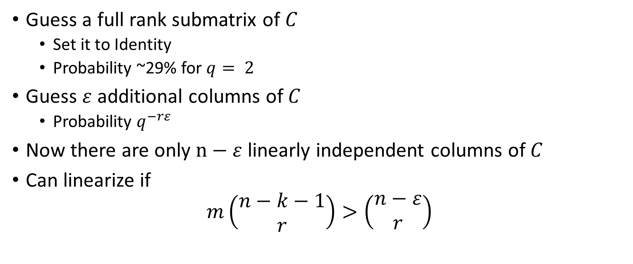
Option 1: Guessing some variables in C
Guess a full rank submatrix of $C$
  Set it to Identity
  Probability ~29% for $q= 2$
Guess $ε$ additional columns of $C$
  Probability $q^{−rε}$
Now there are only $n−ε$ linearly independent columns of $C$
Can linearize if
$$m\left(\begin{matrix}n−k−1 \\ r\end{matrix}\right)>\left(\begin{matrix}n−ε \\ r\end{matrix}\right)$$

Slide 27
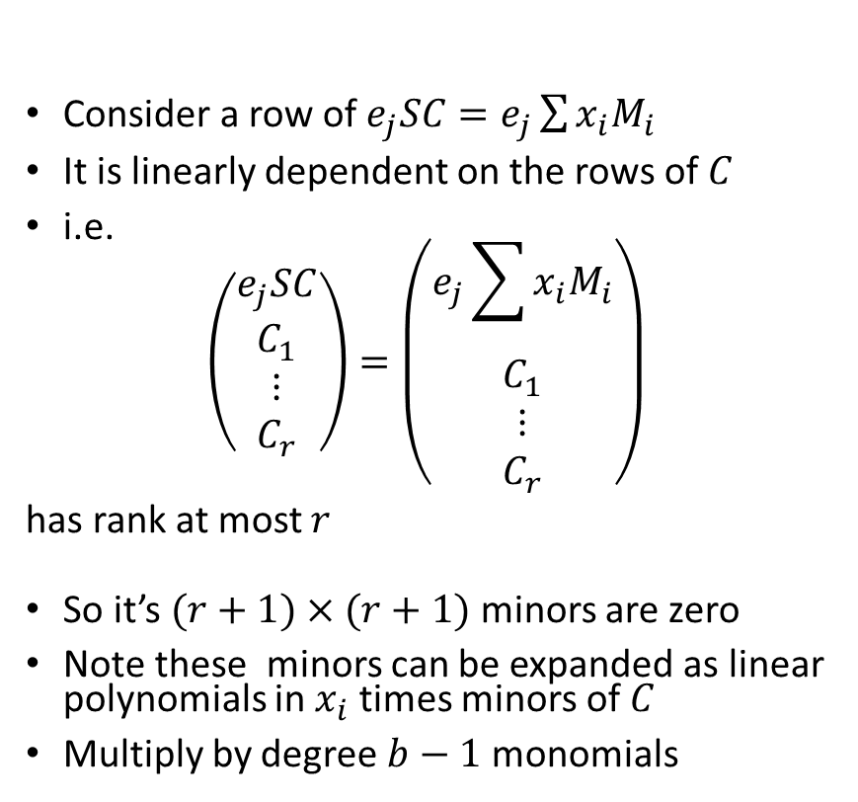
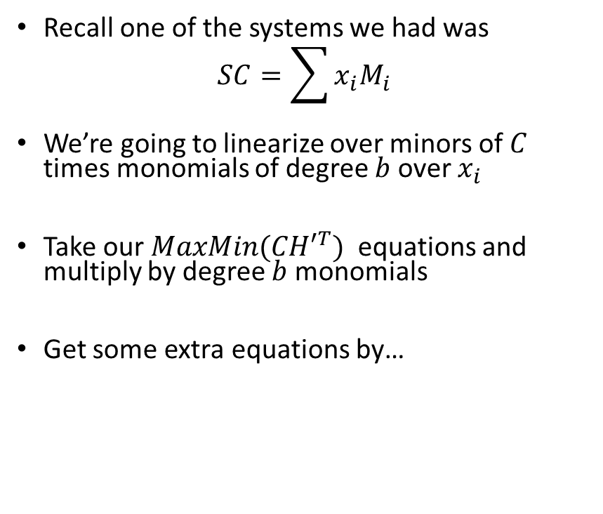
Option 2: Linearizing over something else
Recall one of the systems we had was
$$SC=\sum{x_{i}M_{i}}$$
We’re going to linearize over minors of $C$ times monomials of degree $b$ over $x_{i}$
Take our $MaxMin({CH′}^{T})$ equations and multiply by degree $b$ monomials
Get some extra equations by…
Consider a row of $e_{j}SC=e_{j}\sum{x_{i}M_{i}}$
It is linearly dependent on the rows of $C$
i.e.
$$\left(\begin{matrix}\begin{matrix}e_{j}SC \\ C_{1}\end{matrix} \\ \begin{matrix}⋮ \\ C_{r}\end{matrix}\end{matrix}\right)=\left(\begin{matrix}\begin{matrix}e_{j}\sum{x_{i}M_{i}} \\ C_{1}\end{matrix} \\ \begin{matrix}⋮ \\ C_{r}\end{matrix}\end{matrix}\right)$$
has rank at most $r$
So it’s $(r+1)×(r+1)$ minors are zero
Note these minors can be expanded as linear polynomials in $x_{i}$ times minors of $C$
Multiply by degree $b−1$ monomials

Slide 28
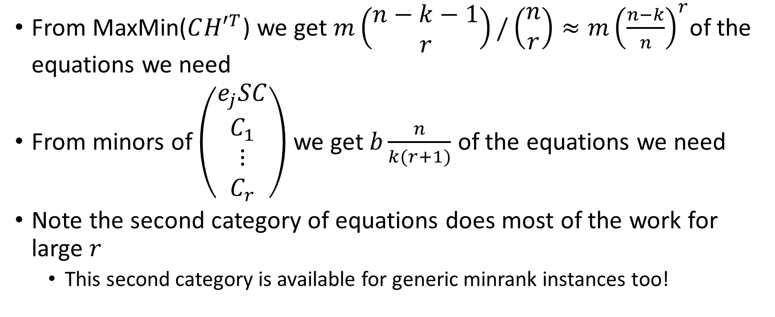

How big does $b$ need to be?
From MaxMin($C{H′}^{T}$) we get $m\left(\begin{matrix}n−k−1 \\ r\end{matrix}\right)/\left(\begin{matrix}n \\ r\end{matrix}\right)≈{m\left(\frac{n−k}{n}\right)}^{r}$of the equations we need
From minors of $\left(\begin{matrix}\begin{matrix}e_{j}SC \\ C_{1}\end{matrix} \\ \begin{matrix}⋮ \\ C_{r}\end{matrix}\end{matrix}\right)$ we get $b\frac{n}{k(r+1)}$ of the equations we need
Note the second category of equations does most of the work for large $r$
  This second category is available for generic minrank instances too!

Slide 29
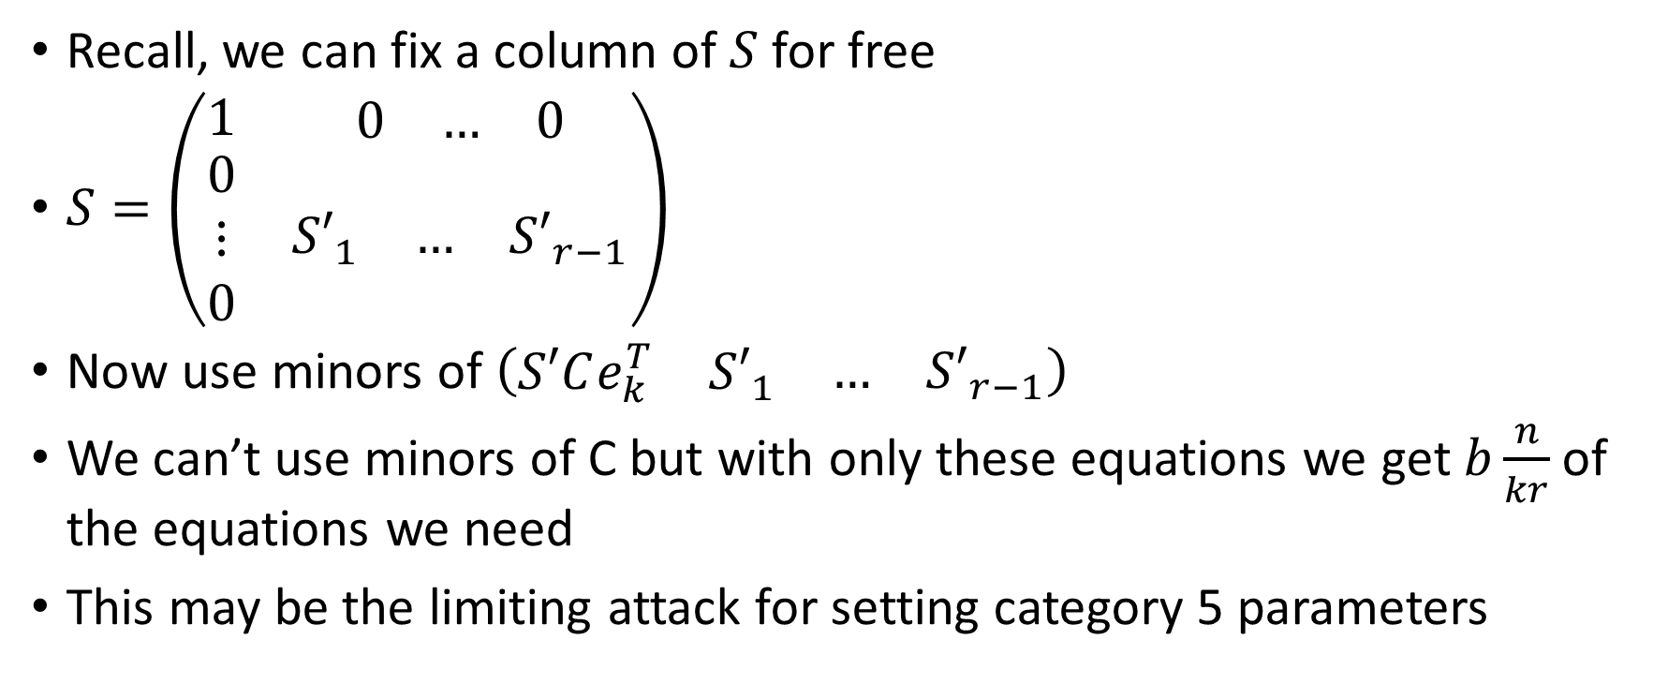
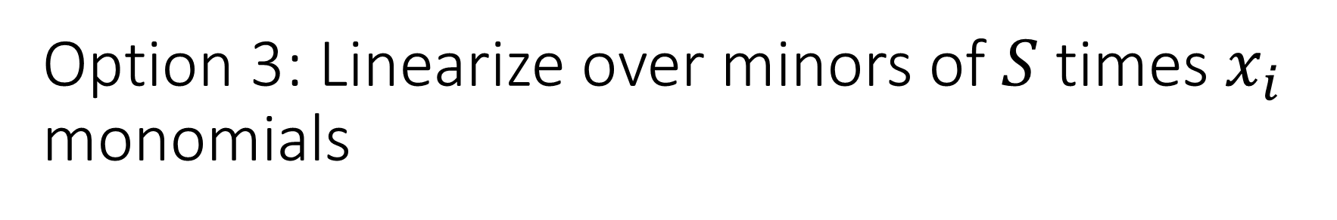
Option 3: Linearize over minors of $S$ times $x_{i}$ monomials
Recall, we can fix a column of $S$ for free
$S=\left(\begin{matrix}1 & \begin{matrix}0 & … & 0\end{matrix} \\ \begin{matrix}0 \\ ⋮ \\ 0\end{matrix} & \begin{matrix}{S′}_{1} & … & {S′}_{r−1}\end{matrix}\end{matrix}\right)$
Now use minors of $\left(\begin{matrix}\begin{matrix}S′Ce_{k}^{T} & {S′}_{1}\end{matrix} & \begin{matrix}… & {S′}_{r−1}\end{matrix}\end{matrix}\right)$
We can’t use minors of C but with only these equations we get $b\frac{n}{kr}$ of the equations we need
This may be the limiting attack for setting category 5 parameters

Slide 30
Complexity estimate from Bardet et al:

Slide 31
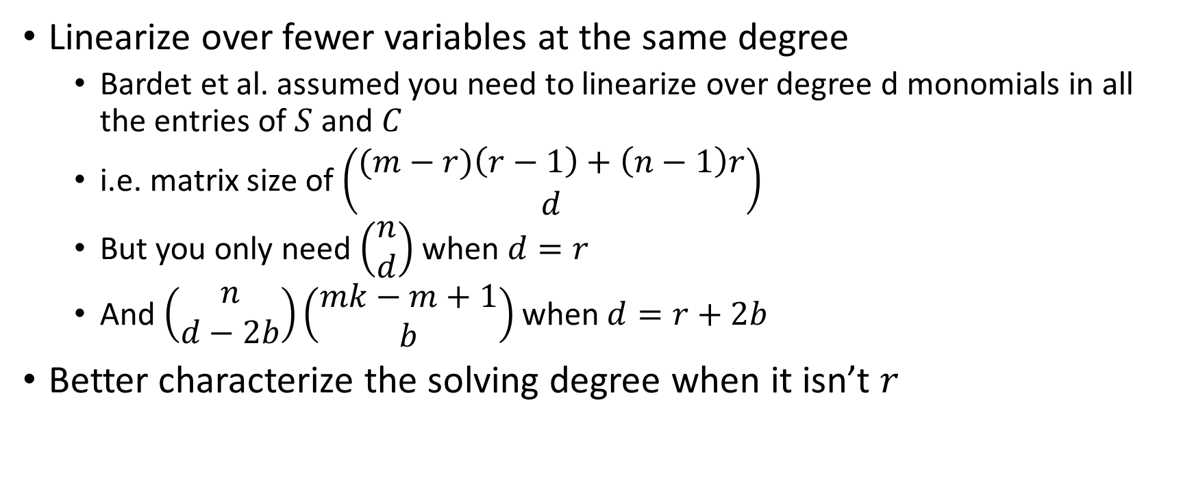
Improvement to Bardet et al.
Linearize over fewer variables at the same degree
  Bardet et al. assumed you need to linearize over degree d monomials in all the entries of $S$ and $C$
  i.e. matrix size of $\left(\begin{matrix}(m−r)\left(r−1\right)+\left(n−1\right)r \\ d\end{matrix}\right)$
  But you only need $\left(\begin{matrix}n \\ d\end{matrix}\right)$ when $d=r$
  And $\left(\begin{matrix}n \\ d−2b\end{matrix}\right)\left(\begin{matrix}mk−m+1 \\ b\end{matrix}\right)$ when $d=r+2b$
Better characterize the solving degree when it isn’t $r$

Slide 32
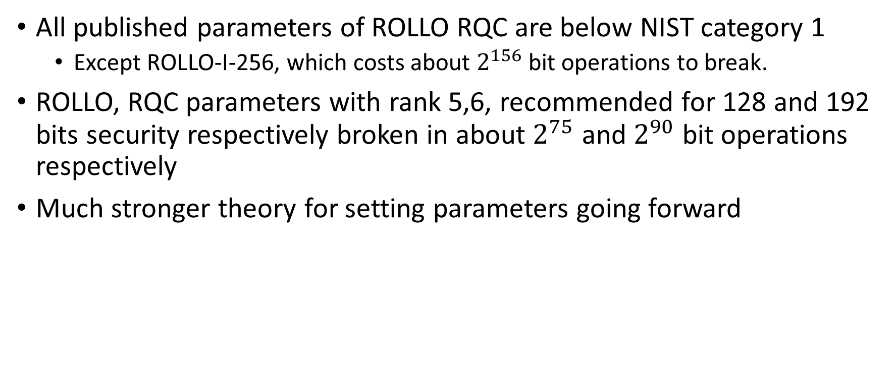
Net effect
All published parameters of ROLLO RQC are below NIST category 1
  Except ROLLO-I-256, which costs about $2^{156}$ bit operations to break.
ROLLO, RQC parameters with rank 5,6, recommended for 128 and 192 bits security respectively broken in about $2^{75}$ and $2^{90}$ bit operations respectively
Much stronger theory for setting parameters going forward

Slide 33
Thank You!
Bonus slides revealing how confused I was 4 months ago follow…

Slide 34
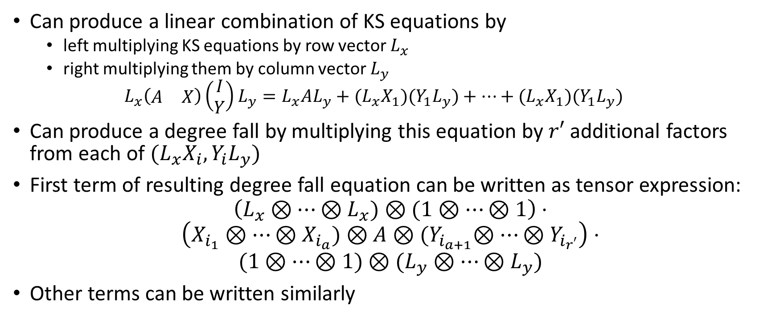
Degree falls in GF(2)
Can produce a linear combination of KS equations by
  left multiplying KS equations by row vector $L_{x}$
  right multiplying them by column vector $L_{y}$
  $$L_{x}\left(\begin{matrix}A & X\end{matrix}\right)\left(\begin{matrix}I \\ Y\end{matrix}\right)L_{y}=L_{x}A{L_{y}+(L}_{x}X_{1})(Y_{1}L_{y})+…+{(L}_{x}X_{1})(Y_{1}L_{y})$$
Can produce a degree fall by multiplying this equation by $r′$ additional factors from each of $(L_{x}X_{i},Y_{i}L_{y})$
First term of resulting degree fall equation can be written as tensor expression:
$$\left(L_{x}⊗…⊗L_{x})⊗(1⊗…⊗1\right)⋅$$
$$\left(X_{i_{1}}⊗…⊗X_{i_{a}})⊗A⊗{(Y}_{i_{a+1}}⊗…⊗Y_{i_{r′}}\right)⋅$$
$$({1⊗…⊗1)⊗(L}_{y}⊗…⊗L_{y})$$
Other terms can be written similarly

Slide 35
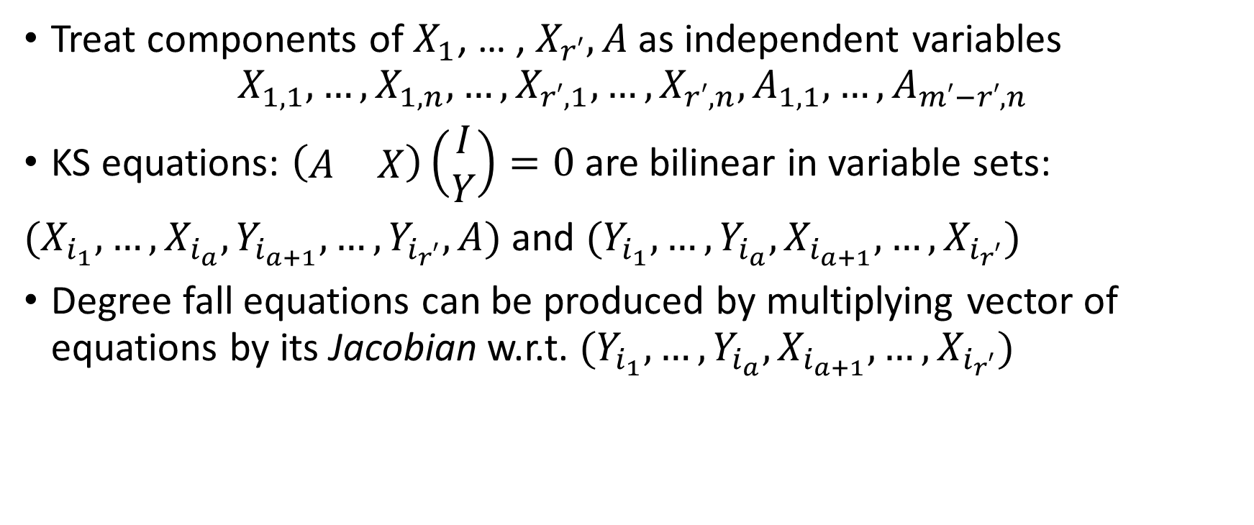
Degree falls from the Jacobian
(Verbel, Baena, Cabarcas, Perlner, Smith-Tone 2019) https://eprint.iacr.org/2019/731.pdf
Treat components of $X_{1}$, … , $X_{r′}, A$ as independent variables
$$X_{1,1},…,X_{1,n}, …,X_{r′,1},…,X_{r′,n}, A_{1,1}, …,A_{m′−r′,n}$$
KS equations: $\left(\begin{matrix}A & X\end{matrix}\right)\left(\begin{matrix}I \\ Y\end{matrix}\right)=0$ are bilinear in variable sets:
$(X_{i_{1}},…,X_{i_{a}},Y_{i_{a+1}},…,Y_{i_{r′}},A)$ and $(Y_{i_{1}},…,Y_{i_{a}}, X_{i_{a+1}},…,X_{i_{r′}})$
Degree fall equations can be produced by multiplying vector of equations by its Jacobian w.r.t. $(Y_{i_{1}},…,Y_{i_{a}}, X_{i_{a+1}},…,X_{i_{r′}})$

Slide 36
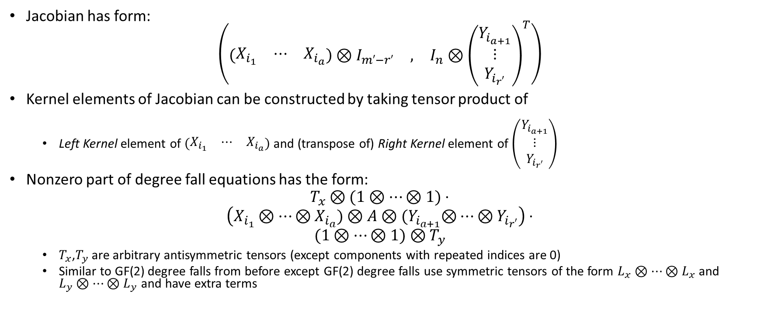
Degree falls from Jacobian (cont.)
Jacobian has form:
$$\left(\begin{matrix}\left(\begin{matrix}X_{i_{1}} & ⋯ & X_{i_{a}}\end{matrix}\right)⊗I_{m′−r′} & , & I_{n}⊗{\left(\begin{matrix}Y_{i_{a+1}} \\ ⋮ \\ Y_{i_{r′}}\end{matrix}\right)}^{T}\end{matrix}\right)$$
Kernel elements of Jacobian can be constructed by taking tensor product of
  Left Kernel element of $\left(\begin{matrix}X_{i_{1}} & ⋯ & X_{i_{a}}\end{matrix}\right)$ and (transpose of) Right Kernel element of $\left(\begin{matrix}Y_{i_{a+1}} \\ ⋮ \\ Y_{i_{r′}}\end{matrix}\right)$
Nonzero part of degree fall equations has the form:
$$T_{x}⊗(1⊗…⊗1)⋅$$
$$\left(X_{i_{1}}⊗…⊗X_{i_{a}})⊗A⊗{(Y}_{i_{a+1}}⊗…⊗Y_{i_{r′}}\right)⋅$$
$$(1⊗…⊗1)⊗T_{y}$$
  $T_{x}$,$T_{y}$ are arbitrary antisymmetric tensors (except components with repeated indices are 0)
  Similar to GF(2) degree falls from before except GF(2) degree falls use symmetric tensors of the form $L_{x}⊗…⊗L_{x}$ and $L_{y}⊗…⊗L_{y}$ and have extra terms

Slide 37
How much do GF(2) degree falls help?
ROLLO and RQC both use GF(2)
GF(2) has both kinds of degree falls
However
  Symmetry and Antisymmetry are the same in GF(2)
  The extra terms in the GF(2)-specific degree falls have fewer degrees of freedom from the first term
  So we expect a high dimensional intersection between the two spaces of degree fall equations
Attacks in GF(2) are probably somewhat cheaper but have the same asymptotics as other choices of GF(q)
Needs more study

Slide 38
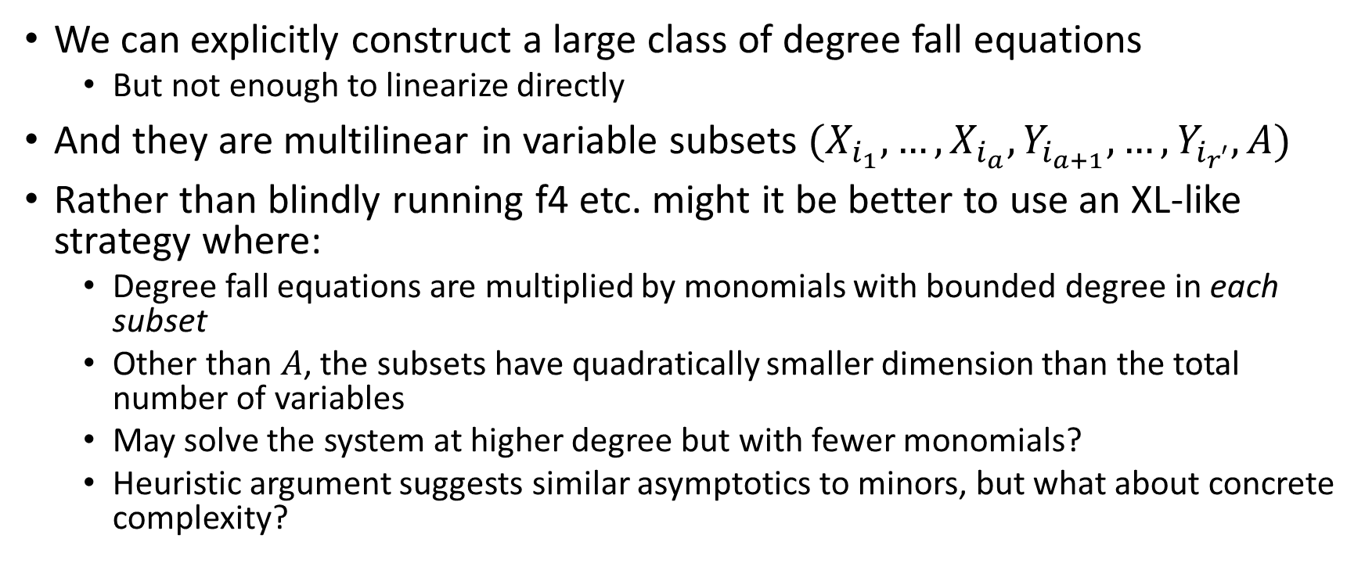
What is the best strategy for solving?
We can explicitly construct a large class of degree fall equations
  But not enough to linearize directly
And they are multilinear in variable subsets $(X_{i_{1}},…,X_{i_{a}},Y_{i_{a+1}},…,Y_{i_{r′}},A)$
Rather than blindly running f4 etc. might it be better to use an XL-like strategy where:
  Degree fall equations are multiplied by monomials with bounded degree in each subset
  Other than $A$, the subsets have quadratically smaller dimension than the total number of variables
  May solve the system at higher degree but with fewer monomials?
  Heuristic argument suggests similar asymptotics to minors, but what about concrete complexity?

Slide 39
Conclusions
Techniques applied to MinRank in multivariate cryptography are useful in analyzing Rank-based cryptography
  In particular the Rank Syndrome Decoding (RSD) problem
However, parameters for MinRank instances coming from RSD are sufficiently different that new analysis is needed
  Especially for analyzing the complexity of KS analysis

