Slide 1
NIST Post-Quantum Cryptography Standardization
Lily Chen
Computer Security Division, Information Technology Lab
National Institute of Standards and Technology (NIST)

Slide 2
NIST Cryptographic Standards
Crypto standards
Public key based
Symmetric key based
Guidelines
AES (FIPS 197 ) TDEA (800-67)
Hash usage/security (800-107)
Signature (FIPS 186)
Modes of operations (800 38A-38G)
Transition (800-131A)
Key establishment (800-56A/B/C)
Key generation (800-133)
SHA-1/2 (FIPS 180) and SHA-3 (FIPS 202)
Key management (800-57)
Tools
Randomized hash (800-106)
RNG (800-90A/B/C)
HMAC (FIPS 198)
KDF (800-108, 800-135)
SHA3 derived functions (parallel hashing, KMAC, etc. (800-185)

Slide 3
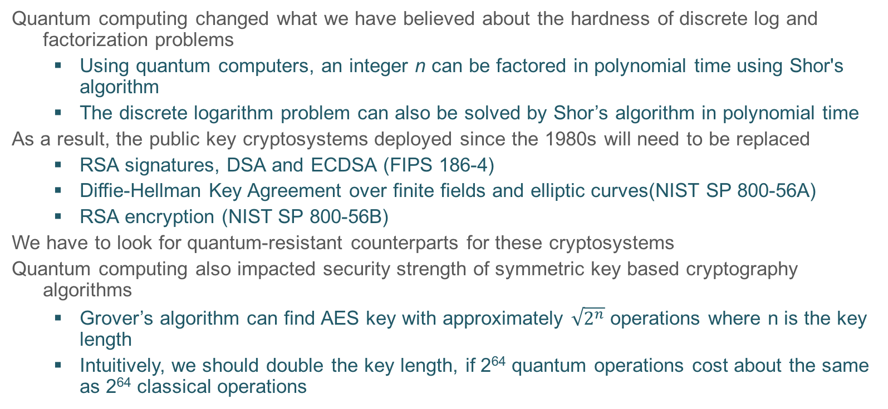
Quantum Impact
Quantum computing changed what we have believed about the hardness of discrete log and factorization problems
  Using quantum computers, an integer n can be factored in polynomial time using Shor's algorithm
  The discrete logarithm problem can also be solved by Shor’s algorithm in polynomial time
As a result, the public key cryptosystems deployed since the 1980s will need to be replaced
  RSA signatures, DSA and ECDSA (FIPS 186-4)
  Diffie-Hellman Key Agreement over finite fields and elliptic curves(NIST SP 800-56A)
  RSA encryption (NIST SP 800-56B)
We have to look for quantum-resistant counterparts for these cryptosystems
Quantum computing also impacted security strength of symmetric key based cryptography algorithms
  Grover’s algorithm can find AES key with approximately $\sqrt{2^{n}}$ operations where n is the key length
  Intuitively, we should double the key length, if 2⁶⁴ quantum operations cost about the same as 2⁶⁴ classical operations
Notes:
Security of most public key cryptography is based on certain hard problems, e.g. RSA – integer factorization, DH – discrete log. Hard – exponent complexity.
We don't need to put it on the slide, but it probably is good to mention the impact on symmetric key cryptography (like AES).
Here we probably should say the difference between the Shor algorithm and Grover algorithm

Slide 4

Quantum Impact to NIST Standards
Crypto standards
Post-Quantum Cryptography
Public key based
Symmetric key based
Guidelines
AES (FIPS 197 ) TDEA (800-67)
Hash usage/security (800-107)
Signature (FIPS 186)
Modes of operations (800 38A-38G)
Transition (800-131A)
Key establishment (800-56A/B/C)
Key generation (800-133)
SHA-1/2 (FIPS 180) and SHA-3 (FIPS 202)
Key management (800-57)
Tools
Randomized hash (800-106)
RNG (800-90A/B/C)
HMAC (FIPS 198)
KDF (800-108, 800-135)
SHA3 derived functions (parallel hashing, KMAC, etc. (800-185)

Slide 5

NIST Team has been in action
2012 – NIST begin PQC project
  Research and build NIST team
April 2015 – 1st NIST PQC workshop
Feb 2016 – NIST Report on PQC (NISTIR 8105)
Feb 2016 – NIST preliminary announcement of standardization plan
Aug 2016 – Draft submission requirements and evaluation criteria released for public comments
Sep 2016 – Comment period ends
Dec 2016 – Announcement of finalized requirements and criteria(Federal Register Notice)
Nov. 30, 2017 – Submission deadline, received 82 submissions
Dec. 24, 2017 – Announced the first round 69 algorithms, as “complete and proper”
Notes:
The project starts in 2011 – 2012 timeframe with an NRC post doc announcement. 2015 we made substantial move. 2016 we made an important decision (NISTIR 8105, announce the preliminary plan, draft call for proposals, etc. )

Slide 6
PQC Families - Actively Researched as Examples
Lattice-based
  NTRUencrypt
  Signature, e.g. Bliss
  (Ring-based) Learning with Errors (e.g. Key Agreement - New Hope)
Code-based
  McEliece encryption and the variants
Multivariate
  Rainbow (signature), Quartz (signature), etc.
Hash-based signatures
  LMS, XMSS, SPHINCS
Isogeny-based schemes
  Supersingular isogeny Diffie–Hellman key exchange (SIDH)
XMSS
LMS
Signatures
Quartz
Bliss
Rainbow
SPHINCS
SIDH
Encryption
Key agreement
McEliece
New Hope
NTRUencrypt

Slide 7
NIST Timeline
NIST will hold the first PQC Standardization Workshop in April 12-13, 2018
Initial analysis phase 12-18 months
Narrow the pool and hold the second workshop in late 2019
Second analysis phase 12-18 month
May take third analysis phase if needed
Expect draft standards in 2022-2023

Slide 8
Submissions to NIST Call for Proposals
Upon the submission deadline (Nov. 30, 2017), NIST received 82 submissions from 26 countries and 6 continents
After an initial review, 69 submissions are considered as complete and proper
At the time of this presentation, 3 of them have been confirmed as “broken” and 66 remains as the first round submissions
46 Key Establishment schemes
  24 lattice-based
  17 code-based
  5 other (2 multi-variate, 1 RSA, 1 random walk, 1 isogeny-based)
20 Signature schemes
  7 multi-variate
  5 lattice
  3 code-based
  3 hash-based (or symmetric based)
  2 other (1 RSA, 1 braids)

Slide 9
Tough Jobs Ahead
Secure analysis against both classical and quantum attacks
Secure against side-channel attacks
Performance evaluation, including
  Computational efficiency
  Key size, signature size, ciphertext expansion
  Handling decryption failure, auxiliary functions, padding, etc.
Drop-in exercise to existing applications, check whether an algorithm can drop in
  a protocol like Internet Key Exchange (IKE) and Transport Layer Security (TLS)
  an application like software authentication (code signing)
  etc.

Slide 10
Join Us for PQC Standardization
For NIST PQC project, please follow us at
  https://csrc.nist.gov/Projects/Post-Quantum-Cryptography
Join discussion mailing list pqc-forum@nist.gov

